Slide 1





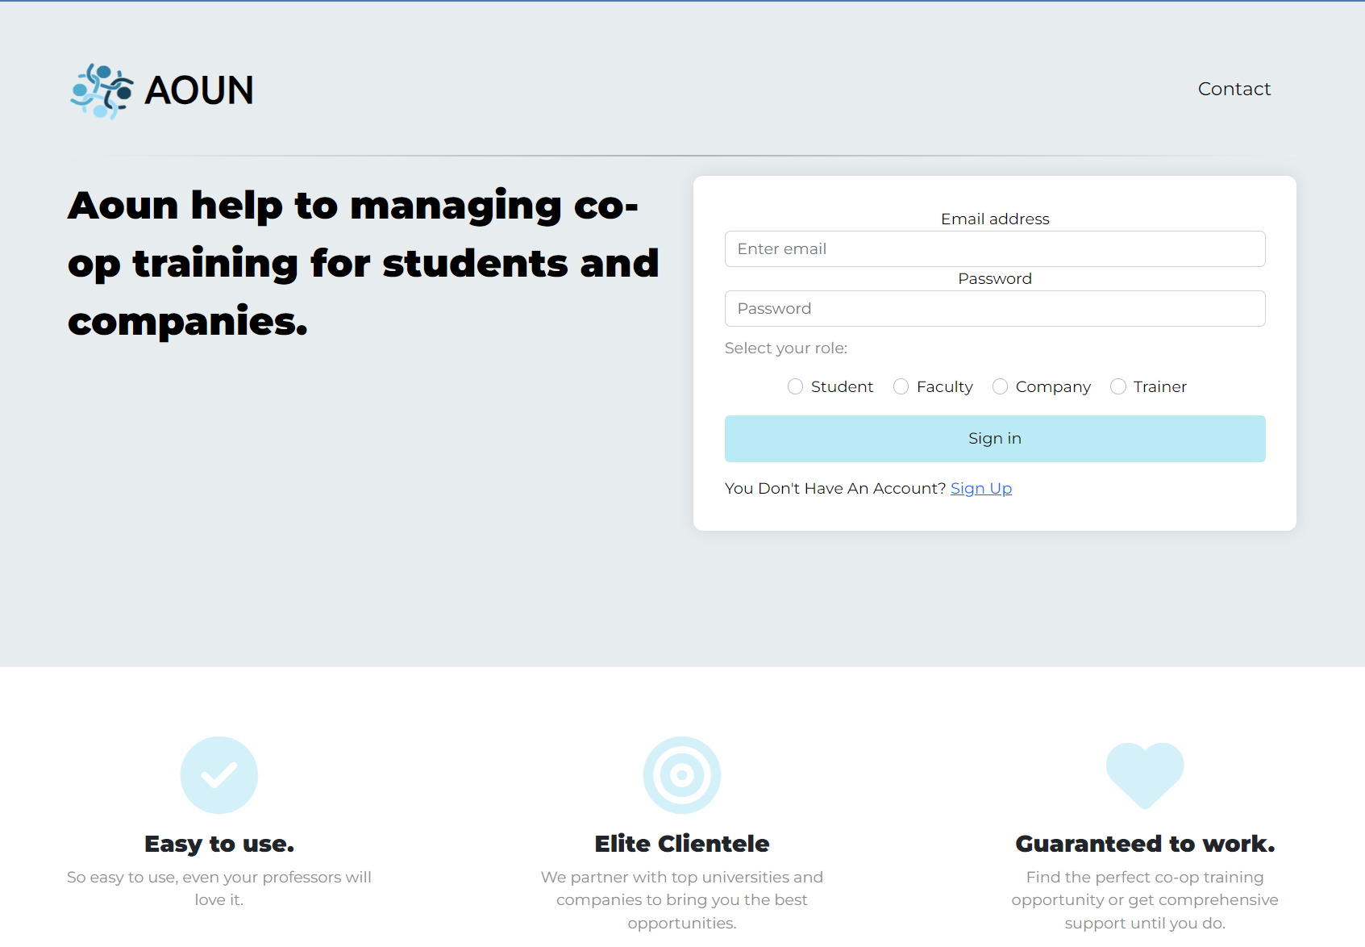
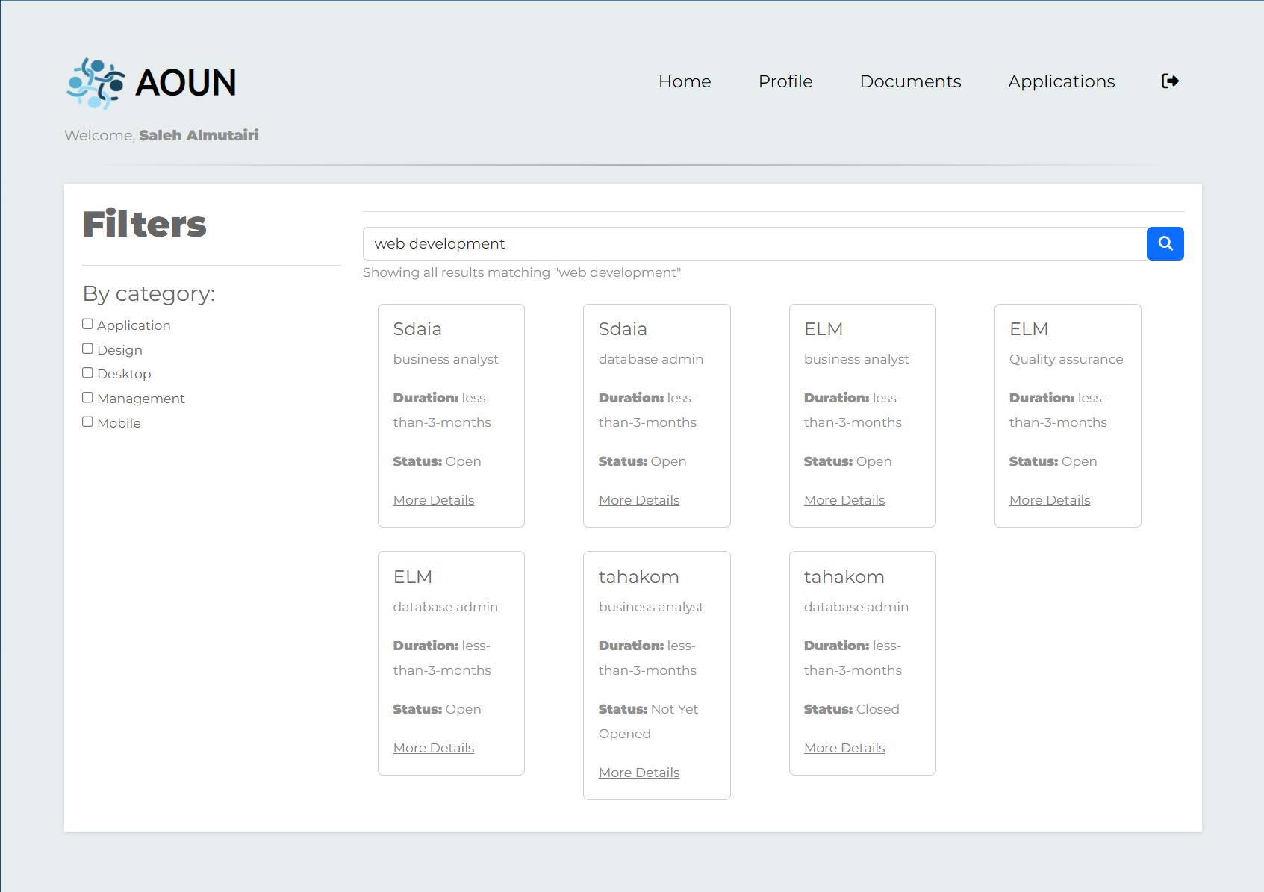



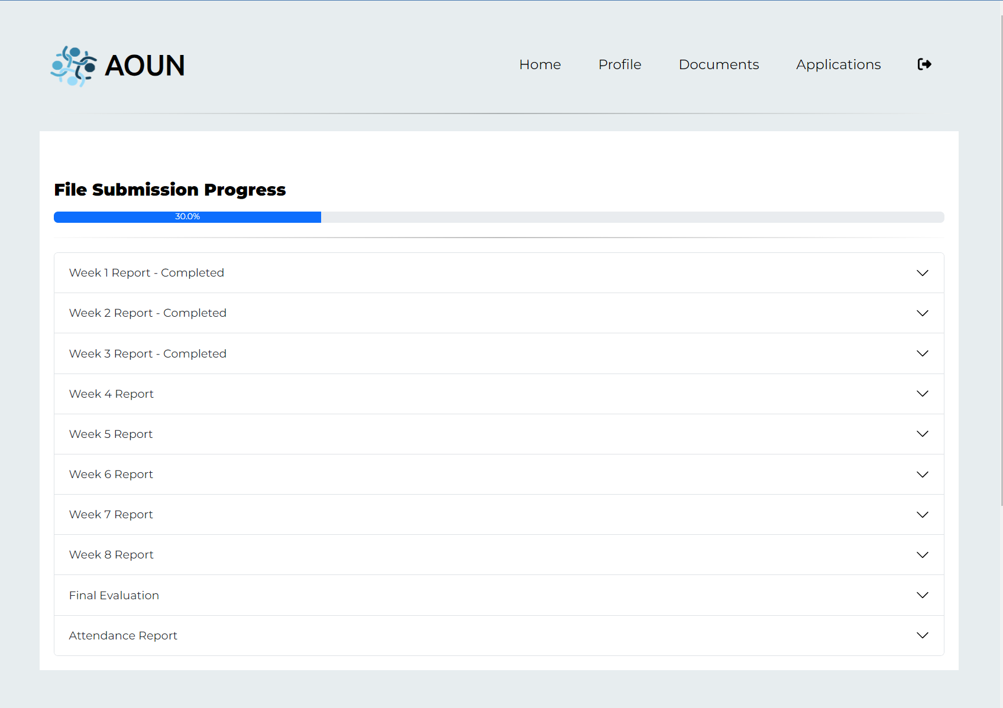


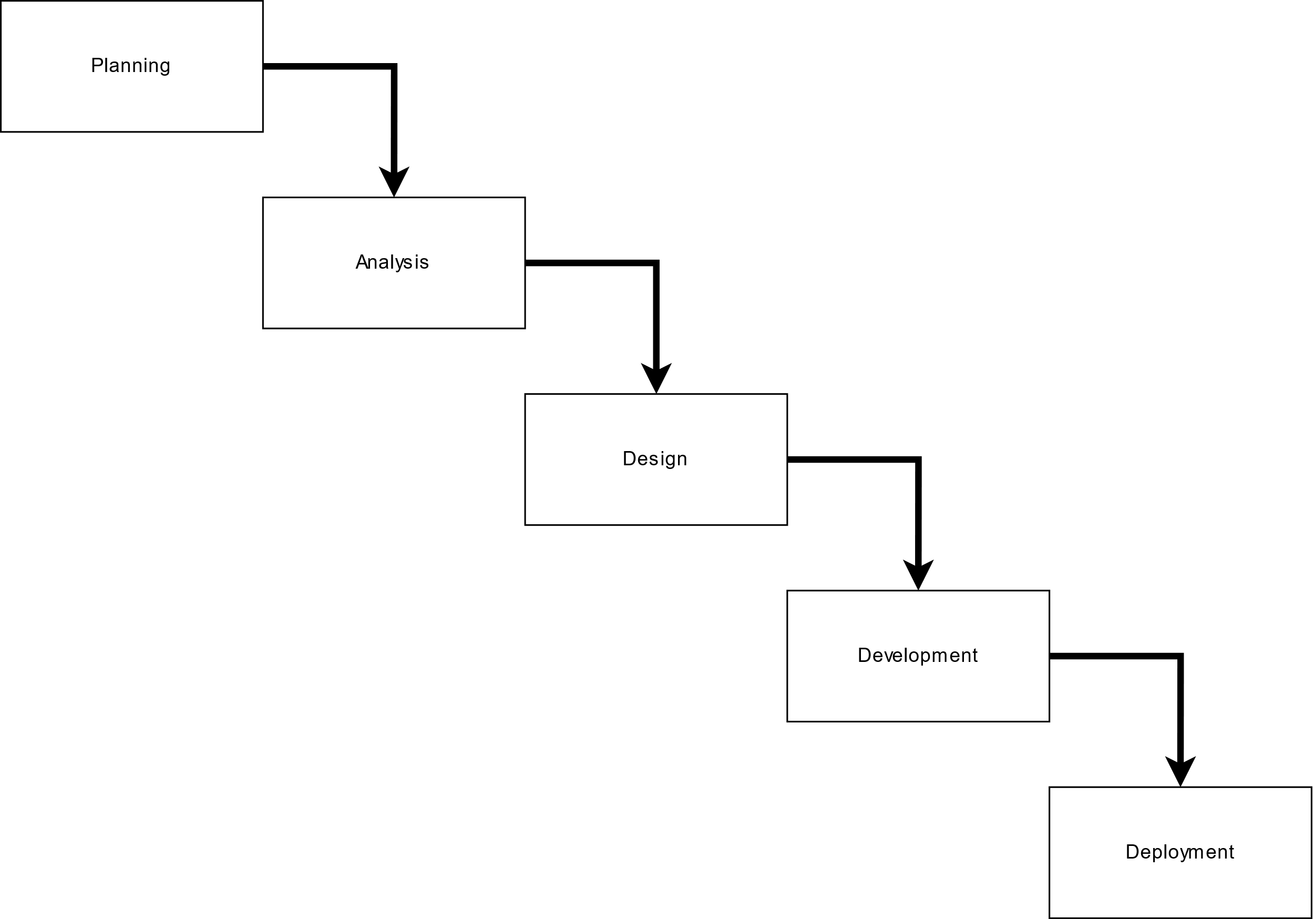
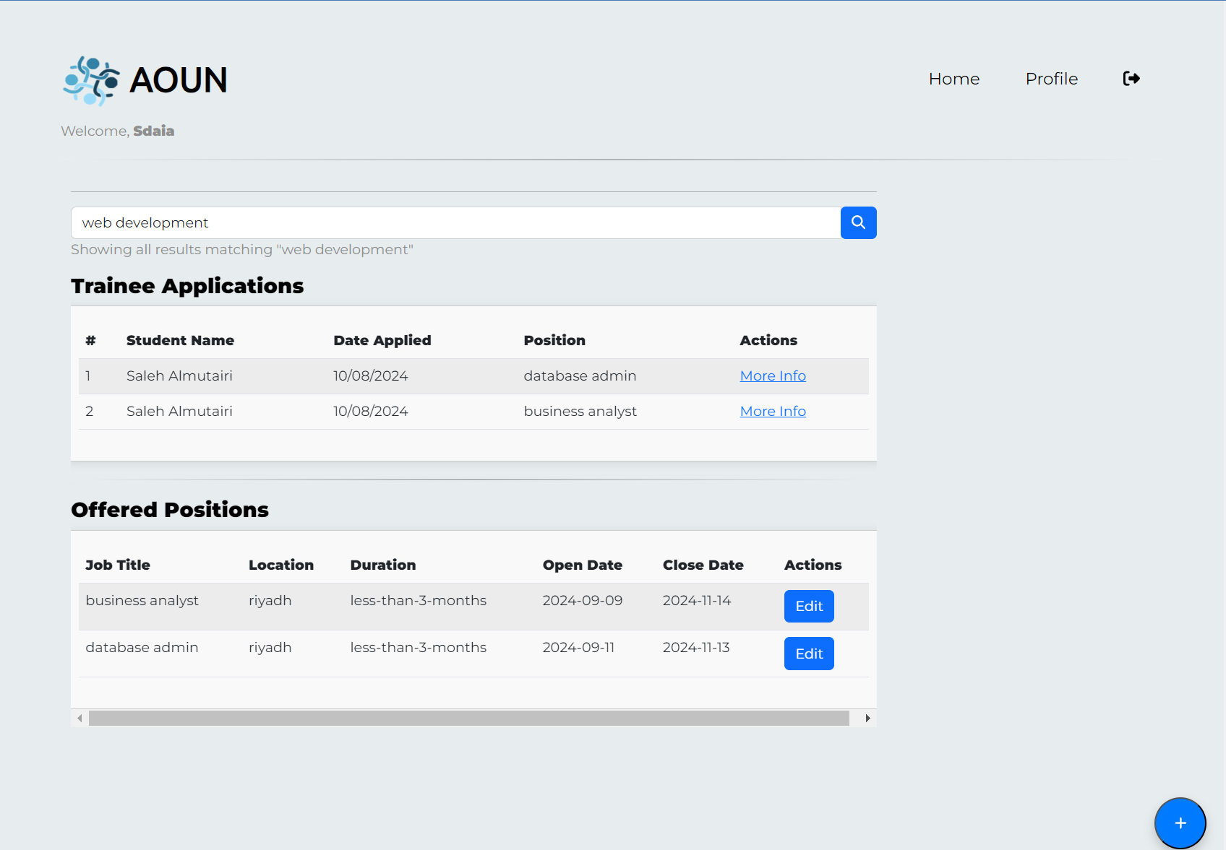
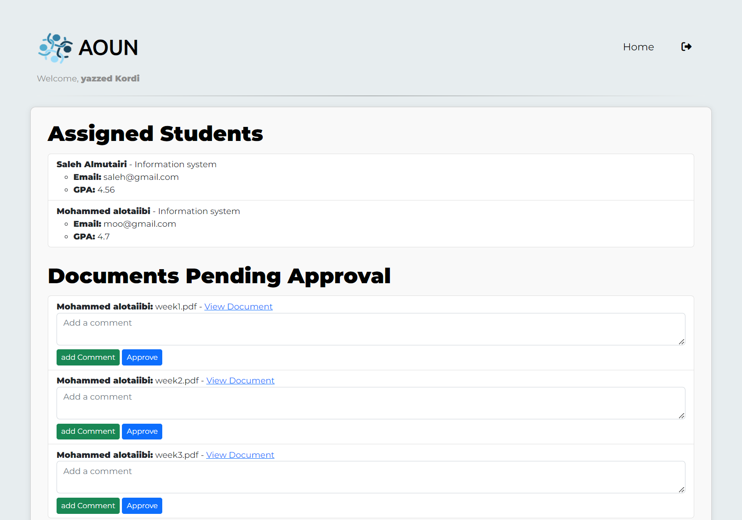

AOUN
[AOUN] [عوُن]
Saleh Almutairi and Yazeed Kordi
Supervisor: Prof. Abdul Khader Jilani Saudagar
Abstract
AOUN Co-op Training application aims to develop an application that consolidates all companies, students, and faculty into a single application. This application will facilitate students in finding suitable cooperative opportunities and automate the process of submitting files for all parties involved. From the student's perspective, the application allows for easy file submission. From the company's perspective, it enables the review and approval of submissions before they are sent to the faculty. From a faculty perspective, the application allows for the review and evaluation of submissions
Methods
System Architecture: The AOUN Cooperative Training System is built as a web application, centralizing interactions among students, companies, and faculty members. Its architecture supports core functionalities such as co-op application management, file submission, and evaluation mechanisms. This centralized platform ensures that each user group can engage effectively, facilitating a smooth and streamlined cooperative training process
Requirement Analysis Methods: To ensure the system meets user needs, requirements were gathered through stakeholder engagement methods, including brainstorming sessions, interviews, and questionnaires. This comprehensive approach provided a clear understanding of the functional and non-functional requirements
Introduction
Problem Statement
AOUN addresses a crucial issue: the lack of a centralized platform for cooperative training opportunities, which impacts both students nearing graduation and the institutions guiding them.
Students struggle to find relevant co-op positions and managing their weekly reports, while organizations face inefficiencies and coordination issues
Context and Significance
The importance of cooperative education in bridging the gap between academia and industry. Students gain valuable hands-on experience that enhances their employability, while organizations can retain talent and build a more skilled workforce
Background and Related Works
Research findings that underline the importance of co-op programs for students’ employment outcomes, such as higher starting salaries and increased job opportunities after graduation.
Organizations providing these opportunities report higher retention rates among participants, highlighting the mutual benefits
Objectives
AOUN’s goal is to help students find cooperative training easily, as well as help companies find students for training, and this is done by achieving the following objectives:
Enhancing Co-op Program Access
Facilitate students' access to training opportunities through a seamless application process that connects them with relevant companies
Streamlining Administration
Establish robust communication between companies, faculty, and students to ease the administration of co-op programs. This ensures smooth coordination and improves the overall training experience
Optimizing Evaluation
Simplify the evaluation process, enabling faculty to review and assess students’ progress effectively. Trainers can approve submitted forms, ensuring thorough and continuous improvement in training outcomes
Conclusion
AOUN addresses the challenges regarding the current process of the cooperative training, Offering a web-based application solution, streamlining processes, creating an application that connects all students, companies, and faculty members
AOUN Application facilitates easier access for students to apply for cooperative opportunities and discovering positions , allowing companies to find suitable candidates by offering positions, simplifies document submission, managing cooperative programs, and enhances communication
IS Department
1446, Semester#1

